Slide 1



School of Computing and Information Technology, Eastern International University (EIU) - Vietnam

Slide 2
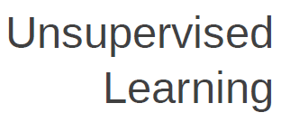



School of Computing and Information Technology, Eastern International University (EIU) - Vietnam

Slide 3

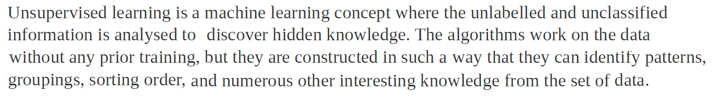
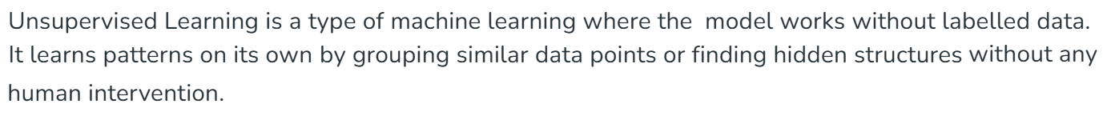
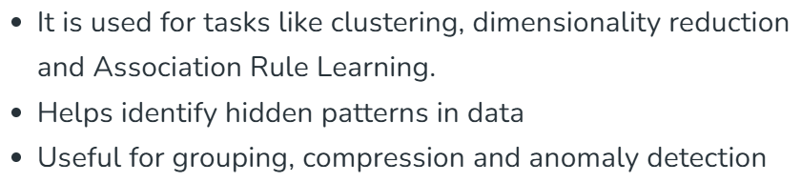
School of Computing and Information Technology, Eastern International University (EIU) - Vietnam

Slide 4
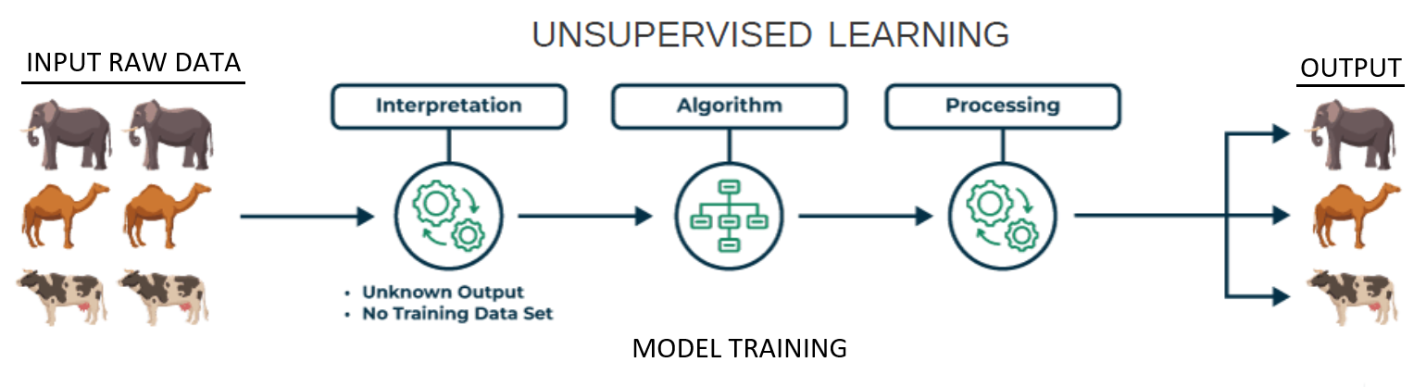
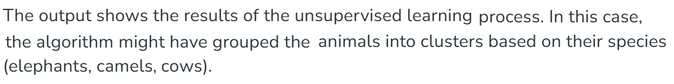
School of Computing and Information Technology, Eastern International University (EIU) - Vietnam

Slide 5

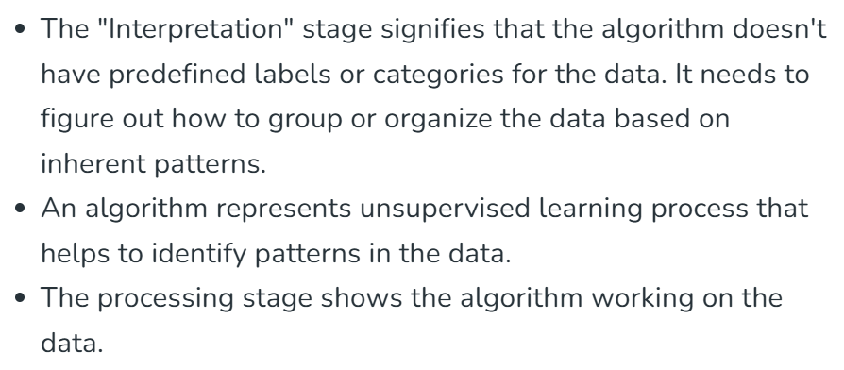
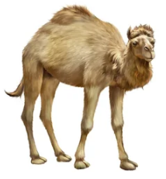

School of Computing and Information Technology, Eastern International University (EIU) - Vietnam

Slide 6

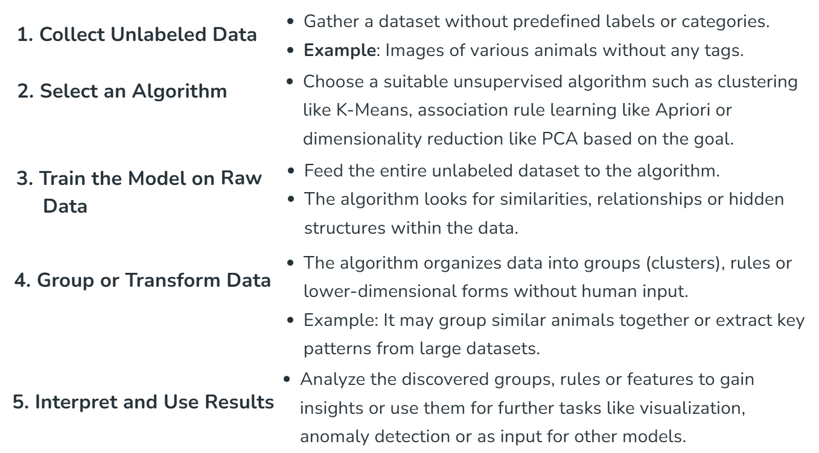

Slide 7
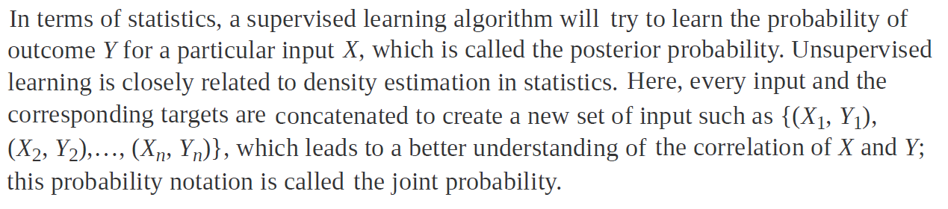
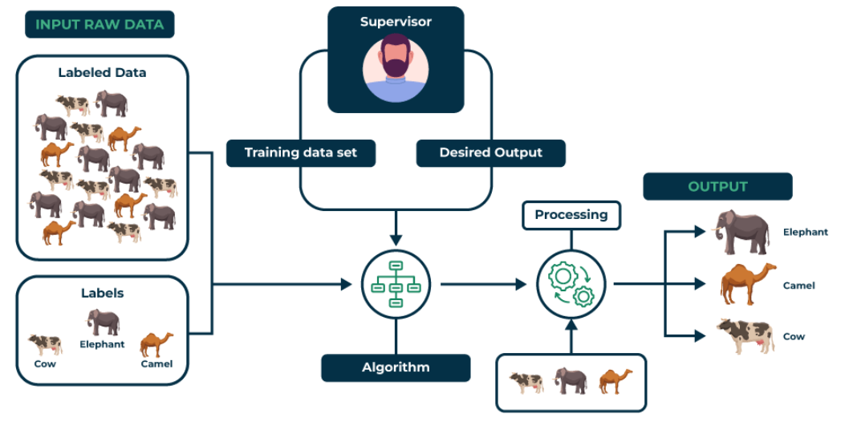
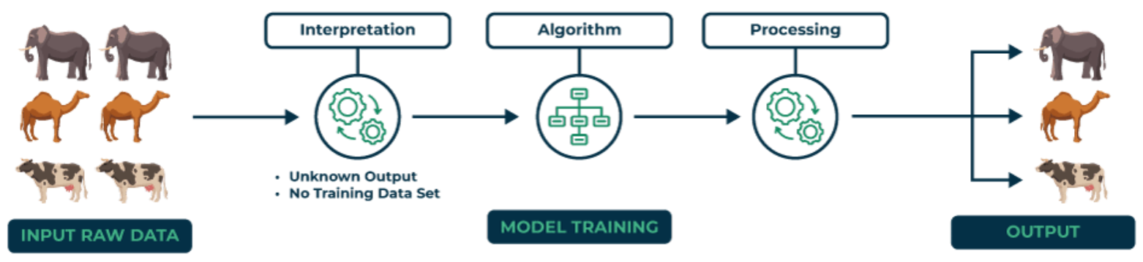


Slide 8

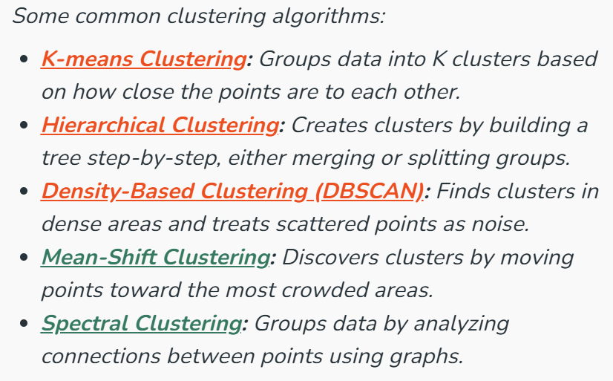
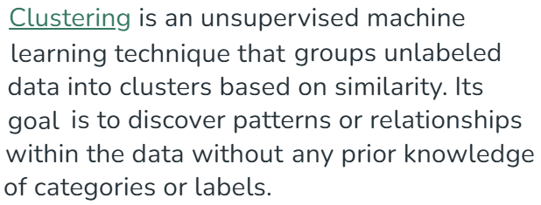
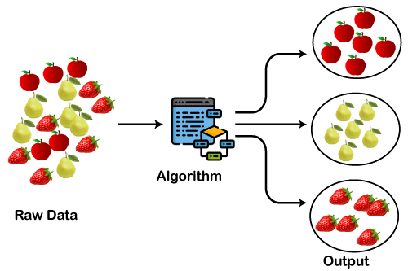

Slide 9

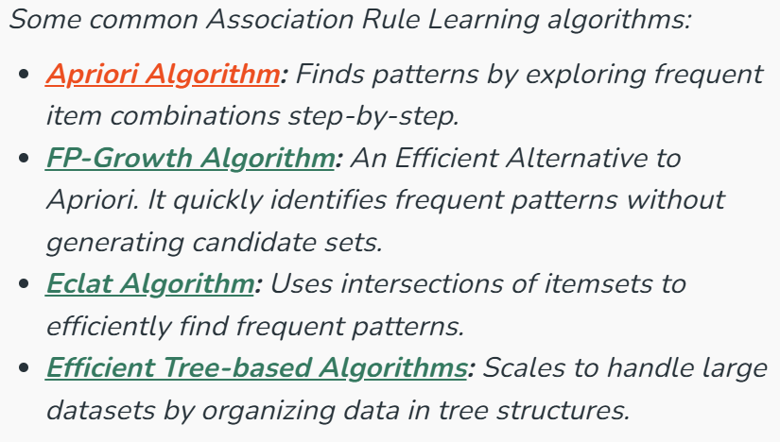
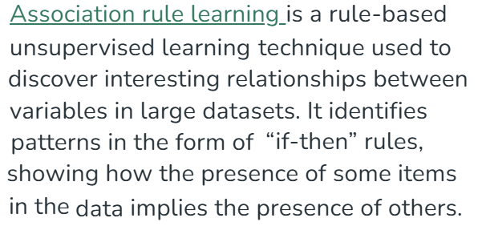
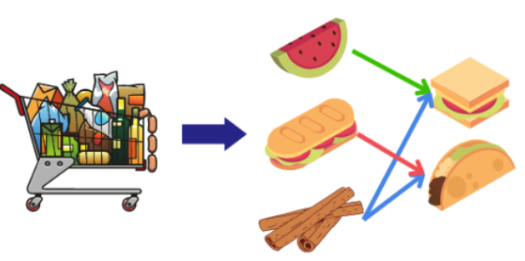

Slide 10

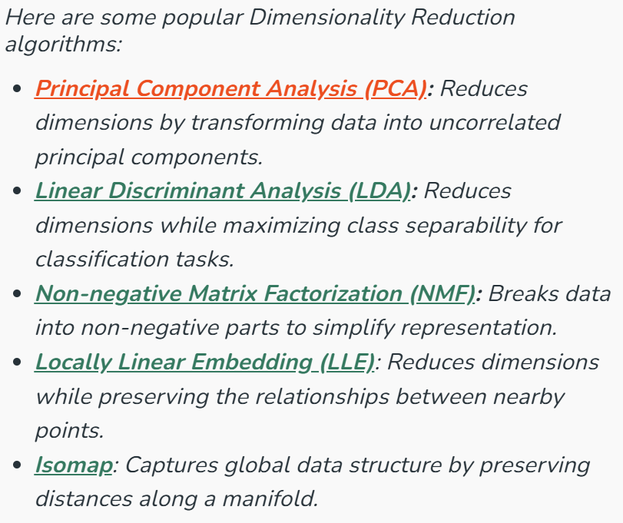
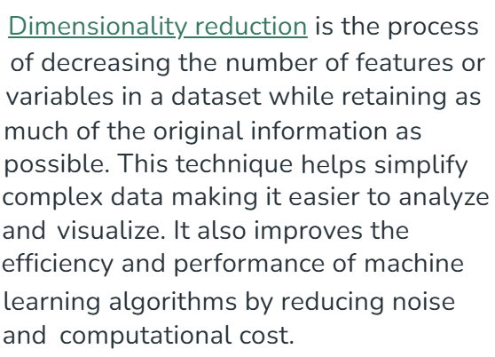
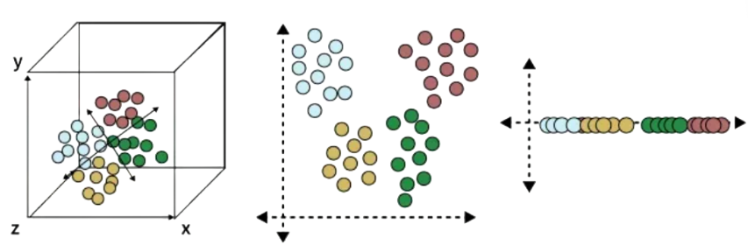

Slide 11
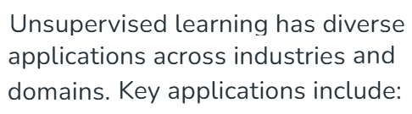
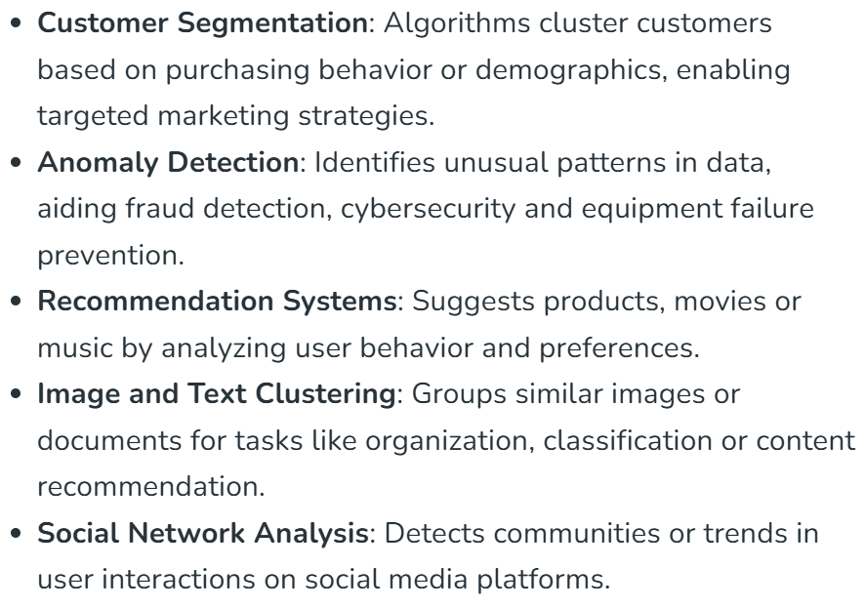
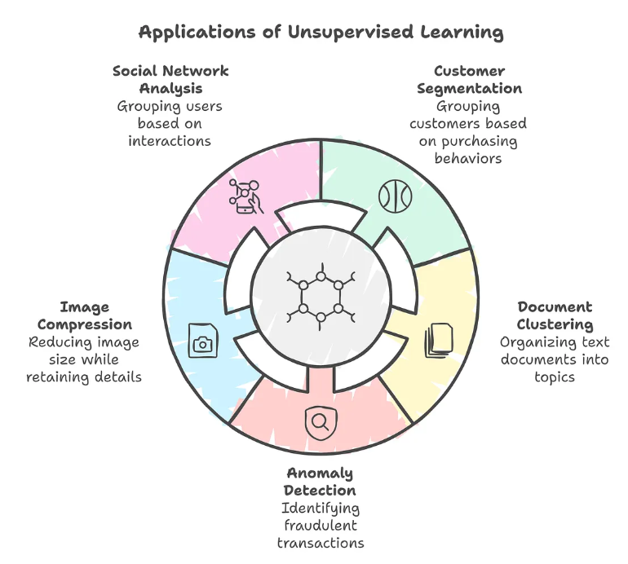
School of Computing and Information Technology, Eastern International University (EIU) - Vietnam

Slide 12

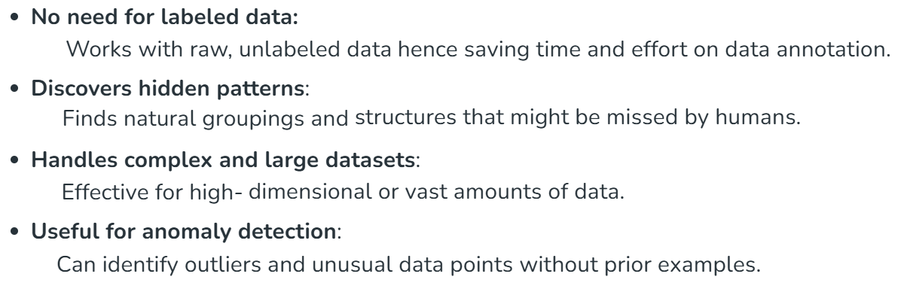
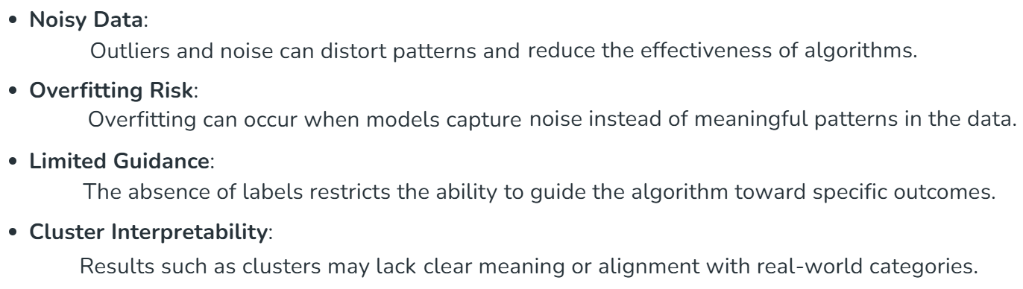


Slide 13

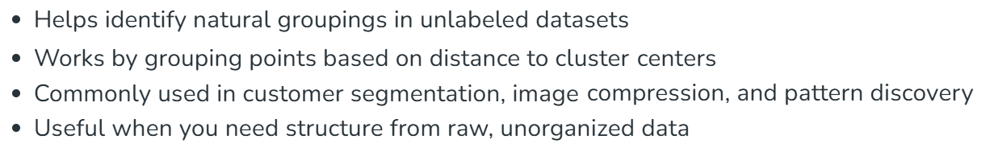
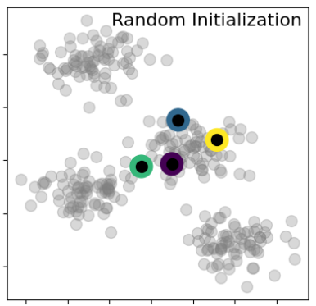
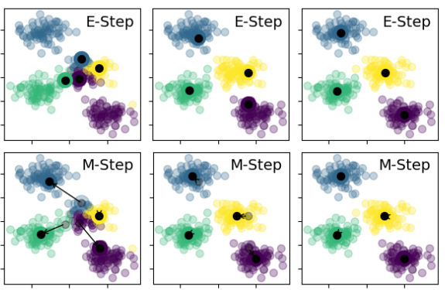
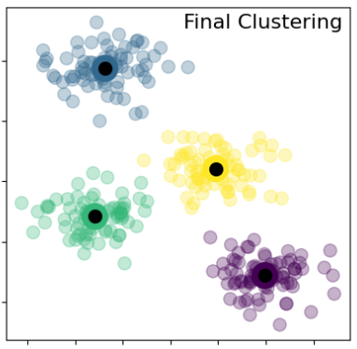
School of Computing and Information Technology, Eastern International University (EIU) - Vietnam

Slide 14
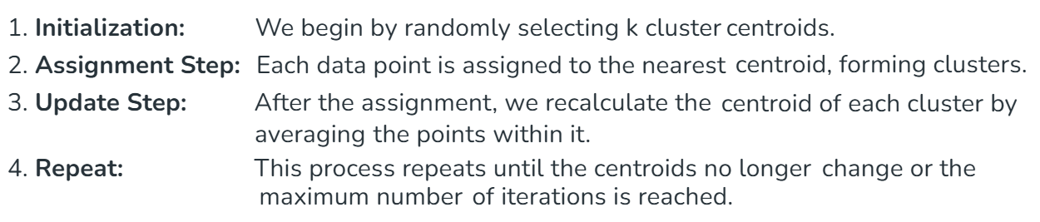
School of Computing and Information Technology, Eastern International University (EIU) - Vietnam

Slide 15

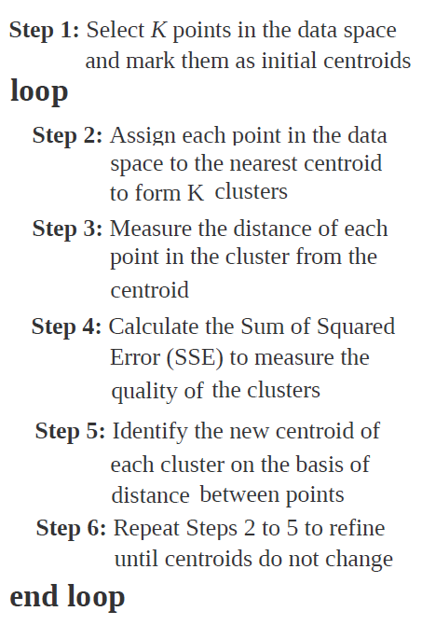
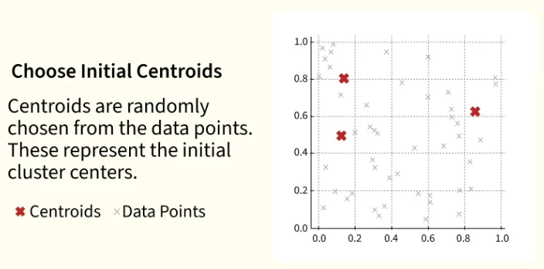
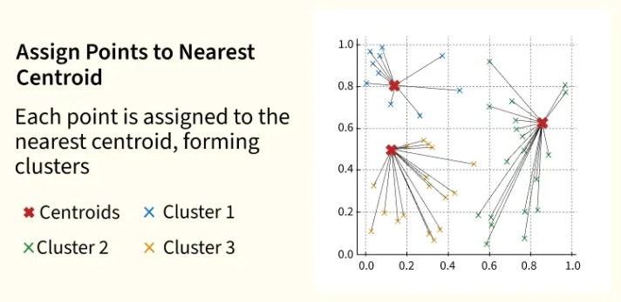
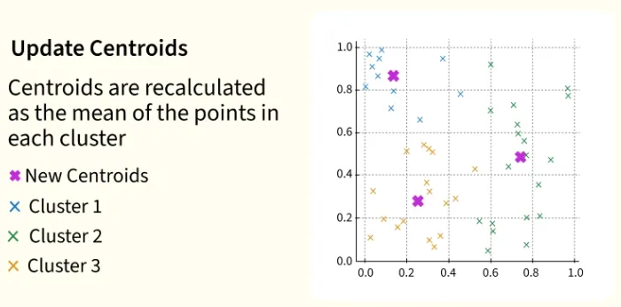
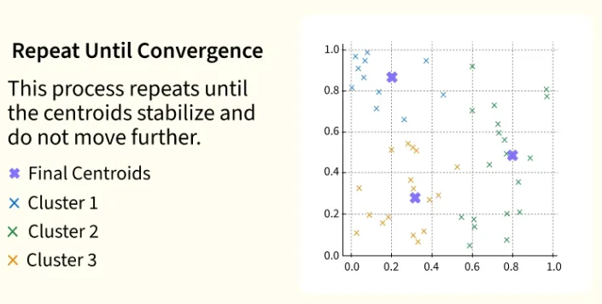

Slide 16
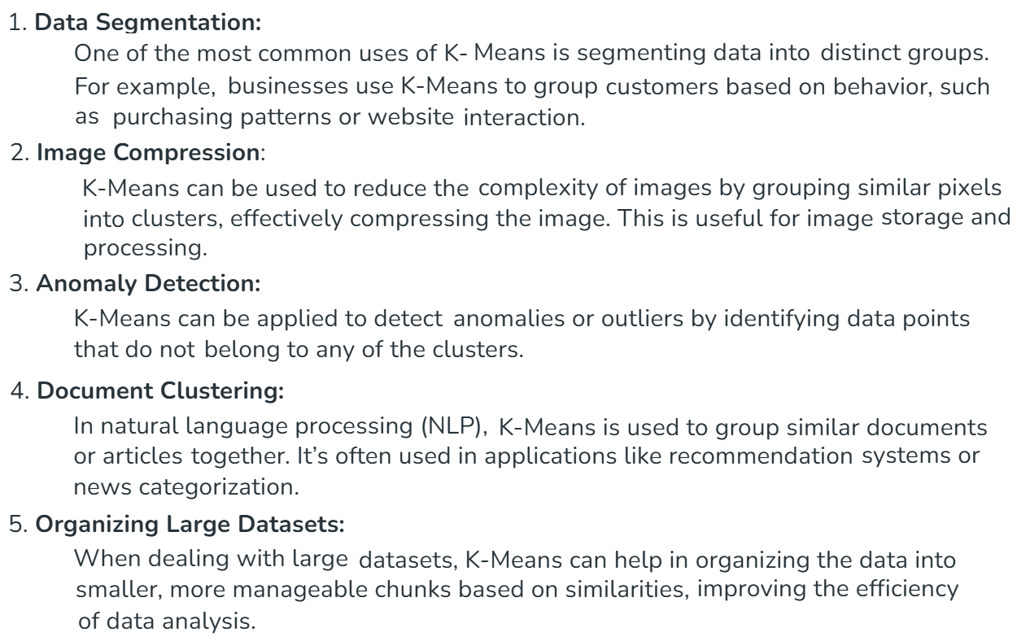

Slide 17
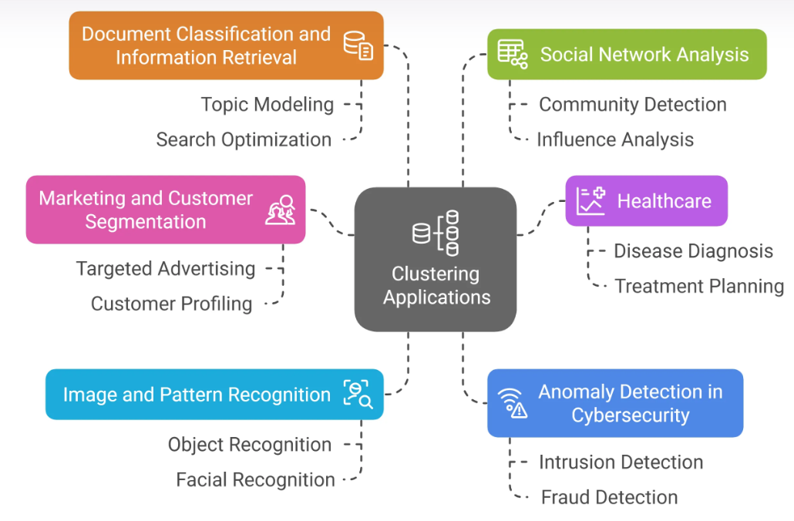
School of Computing and Information Technology, Eastern International University (EIU) - Vietnam

Slide 18
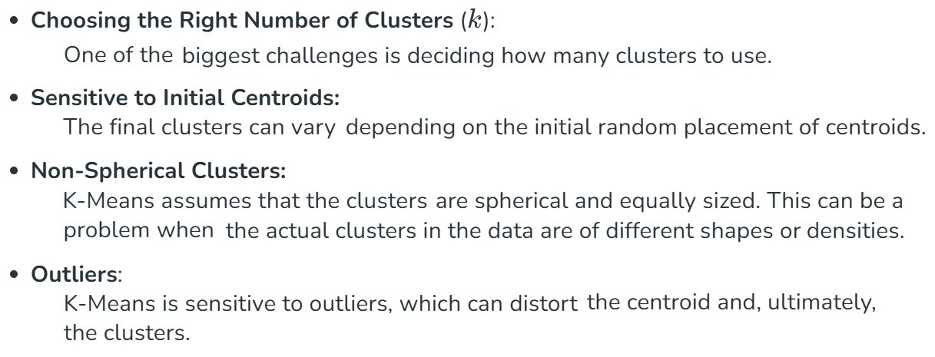
School of Computing and Information Technology, Eastern International University (EIU) - Vietnam

Slide 19
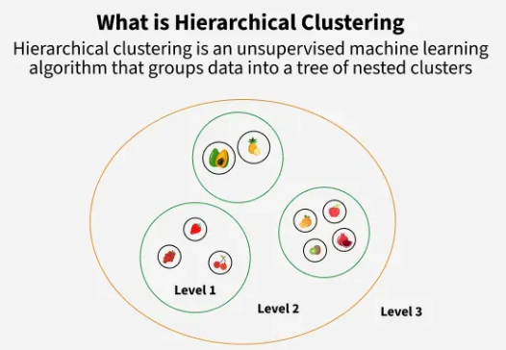
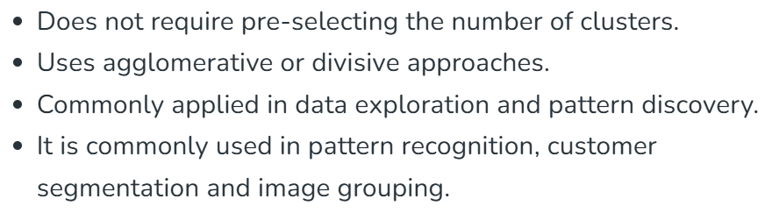
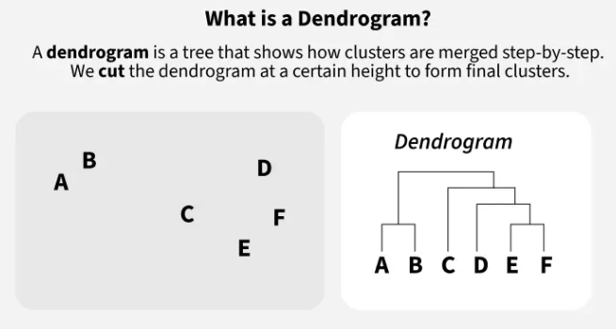
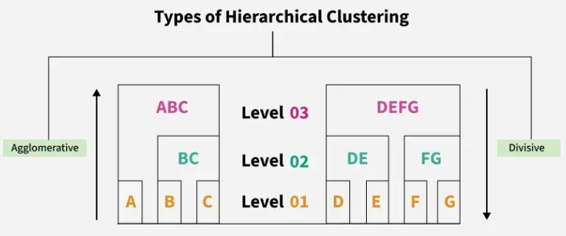

Slide 20
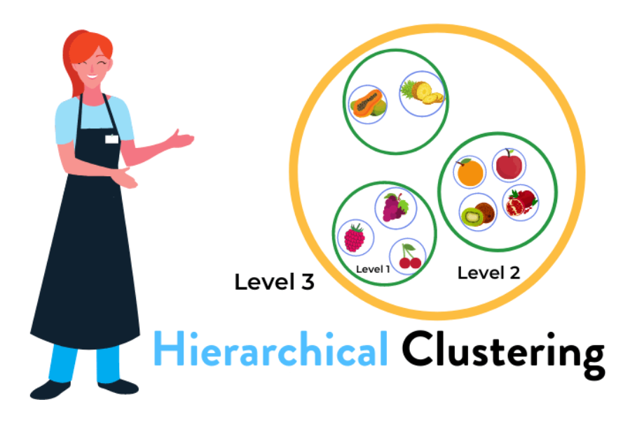
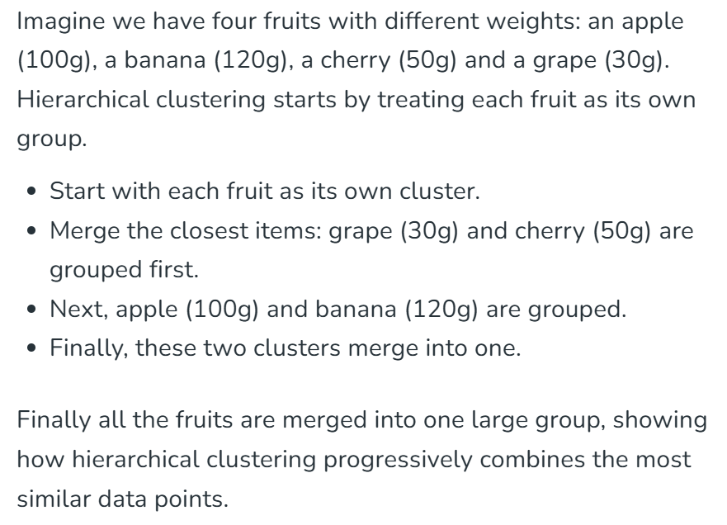
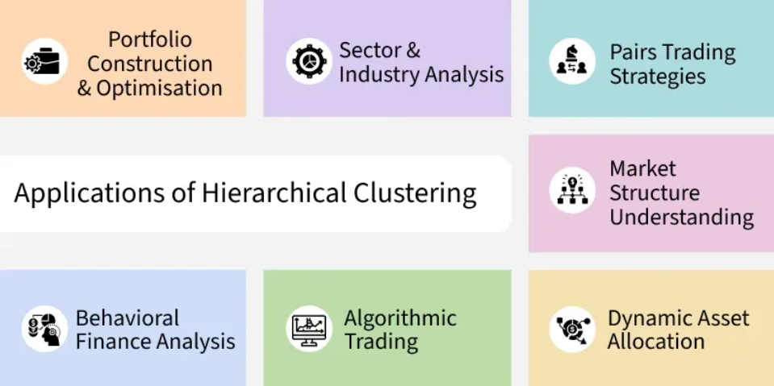
School of Computing and Information Technology, Eastern International University (EIU) - Vietnam

Slide 21

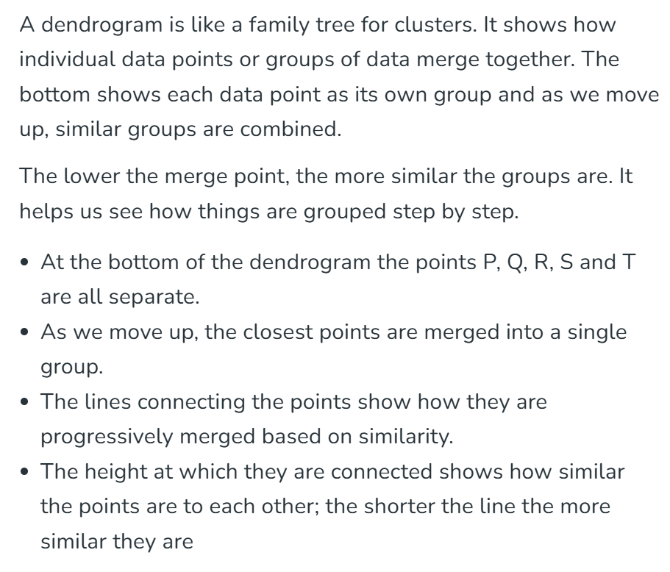
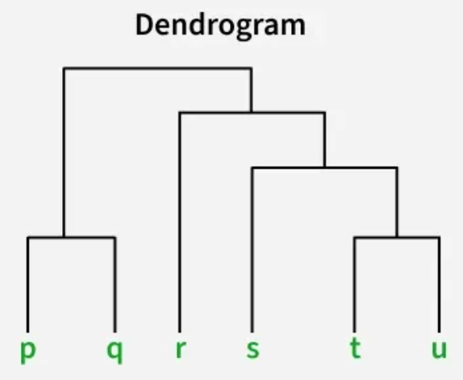


Slide 22
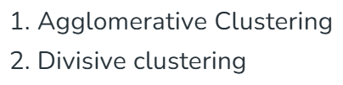

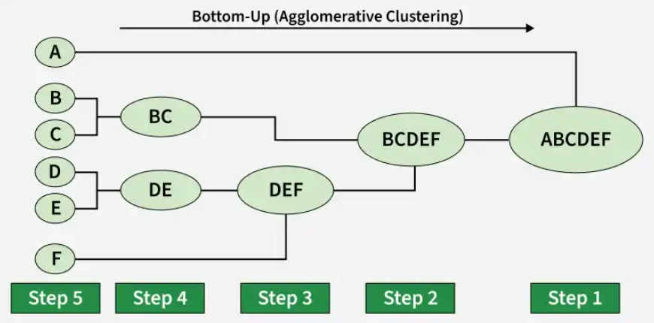
School of Computing and Information Technology, Eastern International University (EIU) - Vietnam

Slide 23

School of Computing and Information Technology, Eastern International University (EIU) - Vietnam

Slide 24



Slide 25






Slide 26



School of Computing and Information Technology, Eastern International University (EIU) - Vietnam

Slide 27

School of Computing and Information Technology, Eastern International University (EIU) - Vietnam

Slide 28




School of Computing and Information Technology, Eastern International University (EIU) - Vietnam

Slide 29

School of Computing and Information Technology, Eastern International University (EIU) - Vietnam

Slide 30



Slide 31









Slide 32


School of Computing and Information Technology, Eastern International University (EIU) - Vietnam

Slide 33



Slide 34

School of Computing and Information Technology, Eastern International University (EIU) - Vietnam

Slide 35

School of Computing and Information Technology, Eastern International University (EIU) - Vietnam

Slide 36

School of Computing and Information Technology, Eastern International University (EIU) - Vietnam

Slide 37








Slide 38





School of Computing and Information Technology, Eastern International University (EIU) - Vietnam

Slide 39




Slide 40





Slide 41






Slide 42


School of Computing and Information Technology, Eastern International University (EIU) - Vietnam

Slide 43



